Slide 1
ECG Using ESP32 Sensor
By:
Harish K
ECE-’A’
SRM Institute of Science and Technology, Trichy

Slide 2
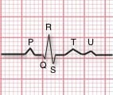
An ECG is a paper or digital recording of the electrical signals in the heart. ECG can be analyzed by studying components of the waveform. An electrocardiogram can be a useful way to find out whether your high blood pressure has caused any damage to your heart or blood vessels.
What is an ECG?

Slide 3

Aim Of The Project
Our project aims to facilitate remote ECG monitoring , enabling patients to consult doctors virtually especially during pandemic induced lockdowns.

Slide 4
Key Features:
IOT ECG analysis for accurate reading
Timely medical interventions through remote monitoring
ECG devices with Wi-Fi connectivity

Slide 5
COMPONENTS Used:
ESP 32
AD8232 SENSOR
BREAD BOARD
ELECTRODES

Slide 6
Electrodes:
Small, plastic patches (electrodes) are put on certain points on the chest and belly (abdomen). The electrodes are connected to an ECG machine by wires. The electrical activity of the heart can be measured, recorded, and printed. No electricity is sent into the body.

Slide 7
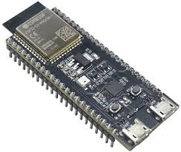
ESP 32:
ESP32 can perform as a complete standalone system or as a slave device to a host MCU, reducing communication stack overhead on the main application processor. ESP32 can interface with other systems to provide Wi-Fi and Bluetooth functionality through its SPI / SDIO or I2C / UART interfaces.

Slide 8
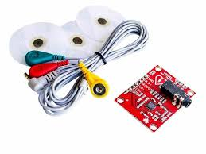
AD8232:
The AD8232 Single Lead Heart Rate Monitor is used to measure the electrical activity of the heart. This electrical activity can be charted as an ECG or Electrocardiogram and output as an analog reading.

Slide 9
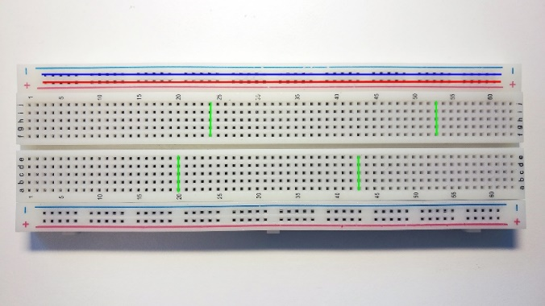
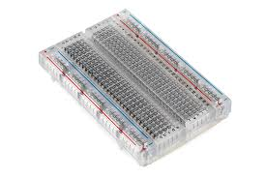
BREAD BOARD:
A breadboard is used for building temporary circuits. It is useful to designers because it allows components to be removed and replaced easily. It is useful to the person who wants to build a circuit to demonstrate its action, then to reuse the components in another circuit

Slide 10
IOT Based ECG Monitoring with AD8232 ECG Sensor & ESP32:
Today I will be showing how to monitor the same ECG graph online on any IOT cloud platform. For that, we will interface AD8232 ECG Sensor with ESP32. And then we will generate an ECG signal by connecting ECG leads to chest or hand. Using UdiBots parameters like API Key or Token we will send the ECG graph to cloud using MQTT Broker. This project can also be done using NodeMCU ESP8266 Board but connections and program need to be modified.

Slide 11
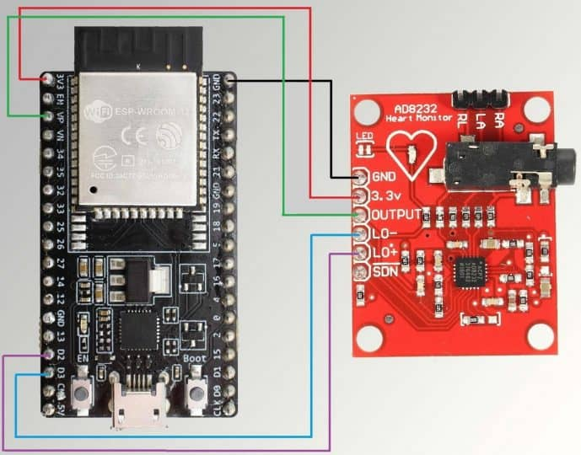
AD8232 ECG Sensor with ESP32 IOT Chip, follow the circuit diagram above. Supply the AD8232 with 3.3V from ESP32 and connect GND to GND. The output pin of AD8232 is an analog signal and is connected to VP pin of ESP32. Similarly LO+ and L0- of AD8232 is connected to D2 & D3 of ESP32.
Remember, there are so many vendors who makes ESP32. All those ESP32 has different pin mapping. I have used ESP32 Board. If you are using any other board then, please take care of the ESP32 Pins while connecting to AD8232.
Circuit connections

Slide 12
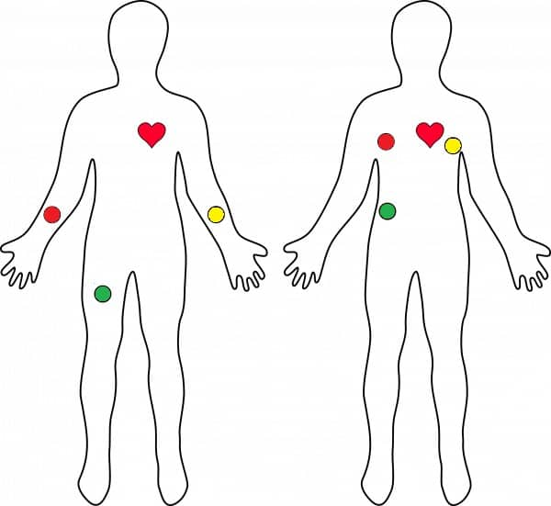
AD8232 ECG Sensor Placement on Body
It is recommended to snap the sensor pads on the leads before application to the body. The closer to the heart the pads are, the better the measurement. The cables are color coded to help identify proper placement.
Red: RA (Right Arm)
Yellow: LA (Left Arm)
Green: RL (Right Leg)

Slide 13
Conclusion:
We hope that our project gave a clear understanding about ECG remote monitoring.
Our project throws light on the potential for improving cardiovascular care and personalized medicine will only expand, emphasizing the importance of ECG monitoring in both clinical and emergency settings

Slide 14
THANK YOU

